Slide 1
Environmental protection in war – banning uranium weapons
Prof. Dr. Manfred Mohr
ICBUW Co Chair
Third International Symposium „The right to truth, justice and salvation“, Nis, 22.-23.9.2023

Slide 2
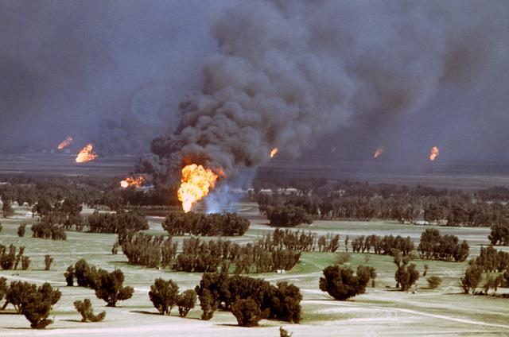
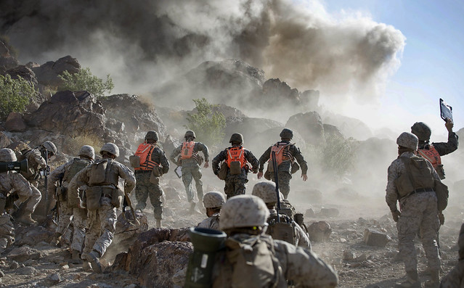
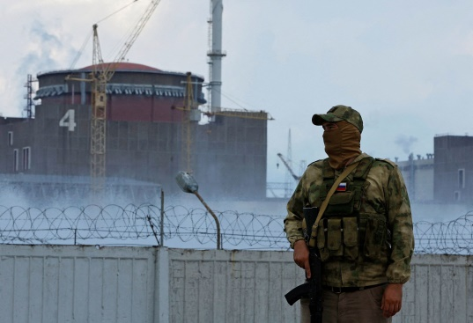
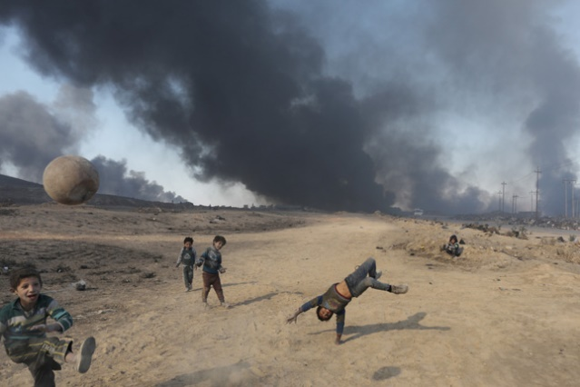
1. Environmental Dimension
Rightly chosen as subject for (3rd) Symposium
(But) clarify exact meaning/too broad
At any rate: more attention to environmental law
Environment as war target in Ukraine – catastrophic scenarios – NGO activities

Slide 3
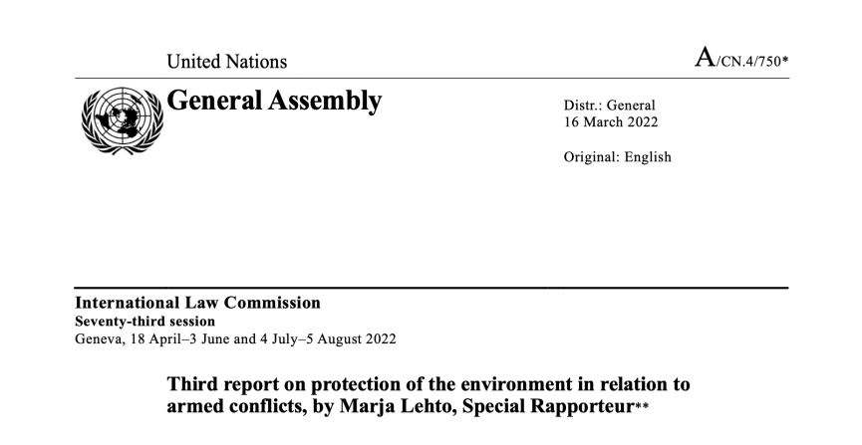
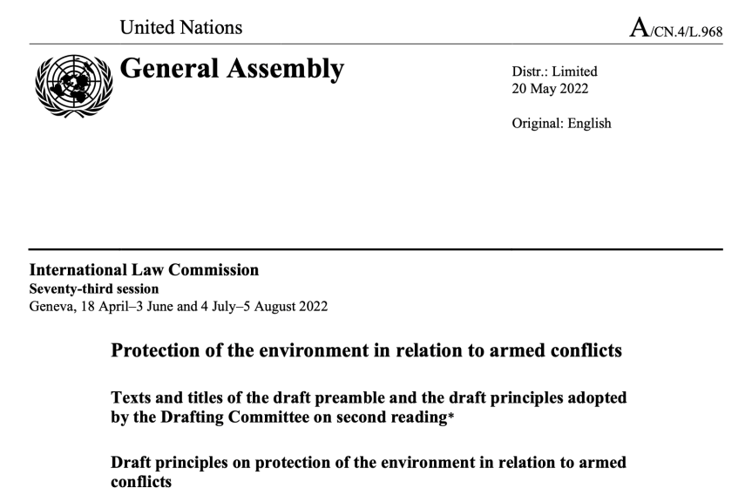
2. Draft Principles on protection of the environment in relation to armed conflict (PERAC)
Adopted 2022 – relevance of ILC “Drafts” – discussion in 6th committee of UNGA
Applicability structure: general/during and after armed conflict/in situations of occupation
Pr. 9 State responsibility: full reparation for damage to the environment
Pr. 26 Remnants of war: remove or render harmless other hazardous remnants of war [“TRW”]

Slide 4
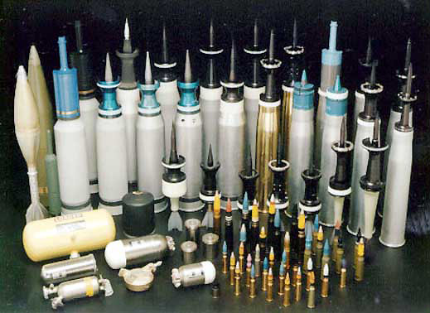
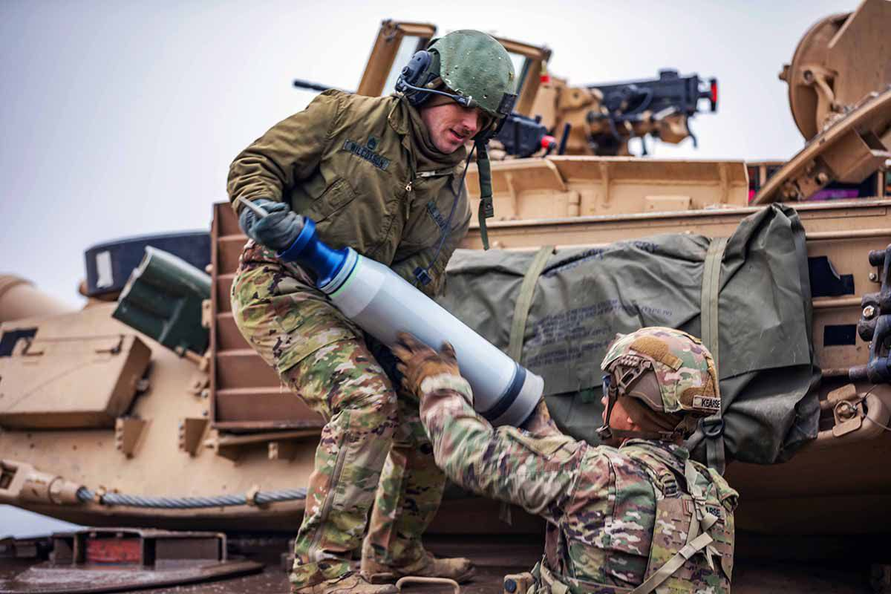
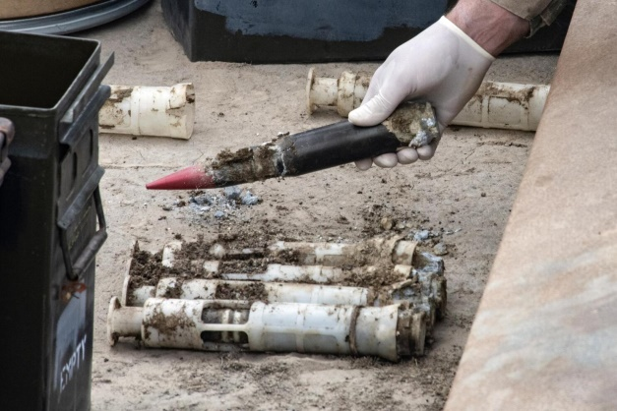
3. Uranium (DU) Weapons
UNEP (2022): environmental impact of the conflict in Ukraine through depleted uranium
UK/US DU deliveries and Russian “reactions”: topic high on the agenda
IHL limits to self-defense (NW Advisory Opinion of the ICJ) – no basis for “DU renaissance” (both sides)
DU transfers/encouragements against Common Art. 1 Geneva Conventions: “respect and ensure respect”

Slide 5
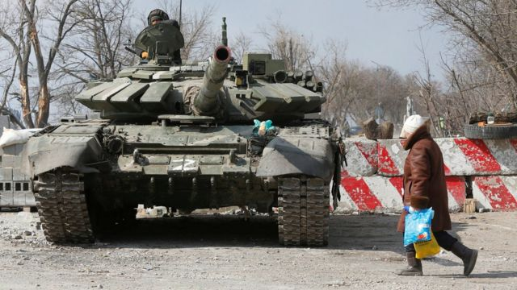
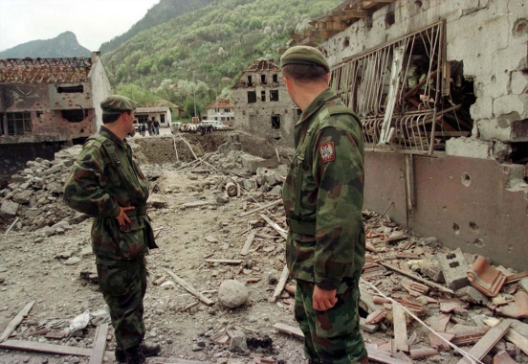
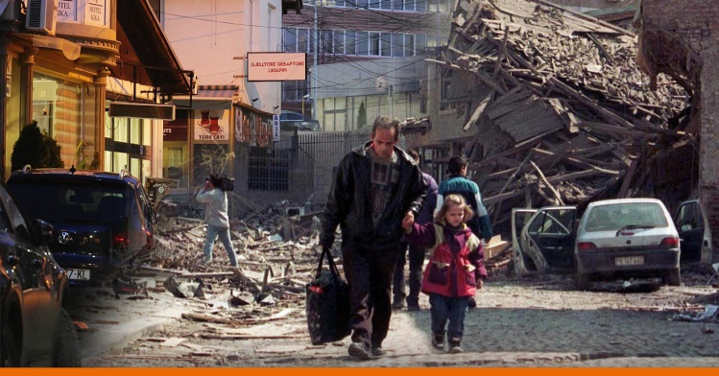
4. Victim Assistance and Environmental Remediation
Parallel to nuclear weapons (TPNW) – 2nd Meeting of States Parties
Firmly rooted in Human Rights Law – relevance of procedures
Shared responsibility: territorial/assisting/user State vs. “no obligation on the UK to help clear up…“
Pragmatic solutions: International Trust Fund – Manufacturer’s liability (Agent Orange ex.)

Slide 6
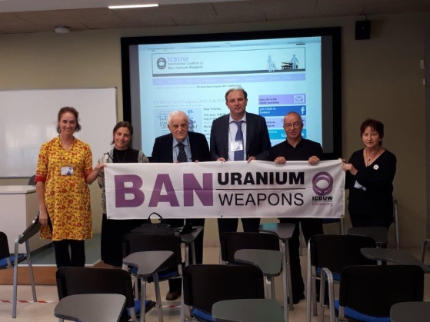
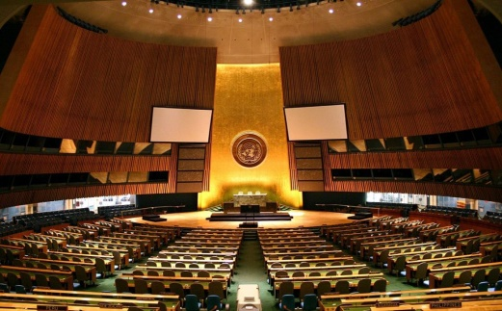
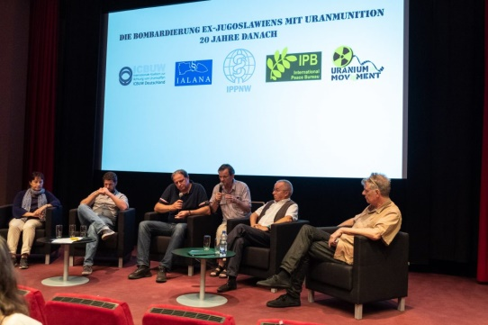
5. Banning Uranium Weapons
Starting point: precautionary principle and prohibition of use (war crime) plus human rights of victims
Broader: illegality of development, stockpiling, transfer…(like laws in Belgium & Costa Rica)
ICBUW Draft Convention (into UN New Agenda for Peace/”Human-Centered Disarmament”) and Global Action Call
More efficient networking and information exchange

